Slide 1
ARTIFICIAL INTELLIGENCE MACHINE LEARNING
LAPTOP PRICE PREDICTION
Supervised by: Submitted by:
Mrs. Shagun Sharma Kunsh Bhandari 2210990529
Lakshay Goel 2210990535
Lakshay Suri 2210990537
Lakshita Chopra 2210990538

Slide 2
Table of Contents
Introduction
Purpose and Objective
Key Features
Methodology
Flowchart
Data Visualization (screenshots
Conclusion
References/Links used

Slide 3
Introduction
In today's digital age, the laptop market is vast and diverse, with prices varying significantly based on a wide range of specifications. Choosing the right laptop can be challenging for consumers who need to balance performance, features, and budget. To address this issue, we have developed an artificial intelligence (AI) machine learning model that predicts laptop prices based on their specifications.

Slide 4
Purpose and Objective
Purpose: To create a reliable, data-driven tool that assists consumers and retailers in understanding and estimating laptop prices.
Objective: To leverage machine learning techniques to analyze and predict the price of a laptop given its technical specifications such as brand, processor type, RAM, storage, screen size, and more.

Slide 5
Key Features
Data Collection: Gathering a comprehensive dataset of laptops with various specifications and their corresponding prices.
Feature Engineering: Identifying and preprocessing the most relevant features that influence laptop prices.
Model Development: Training multiple machine learning models to determine the best approach for price prediction.
Prediction: Implementing the final model to predict laptop prices and comparing its predictions with actual market prices.

Slide 6
Methodology
Data Collection:
Obtain a dataset containing information about various laptop models.
Features include brand, RAM, processor, screen size, storage capacity etc.
Kaggle can be used to provide such datasets.
Data Exploration and Preprocessing:
Load the dataset using libraries like Pandas.
Remove irrelevant columns (e.g. 'Unnamed: 0.1','Unnamed: 0', 'name').
Check for missing values and handle them.
Convert alphanumeric data (e.g. GPU, CPU etc.) into usable formats.
Feature Engineering:
Extract relevant features from existing columns.
For example:
Create a “ppi”(pixels per inches) feature based on the presence of display size and resolution dimensions.
Engineer features related to RAM and CPU.

Slide 7
Metholodogy
Exploratory Data Analysis (EDA):
Understand correlations and patterns using corr() function.
Visualize relationships between features and target variable (price) using seaborn and matplotlib.
Model Selection:
Linear Regression as it is simple and easily interpretable.
SVR(Support Vector Regression) as it is a powerful regression technique.
Model Training and Evaluation:
Split the dataset into training and testing sets.
Train the chosen model on the training data.
Evaluate model performance using regression evaluation metrics like R-squared, mean squared error etc.

Slide 8
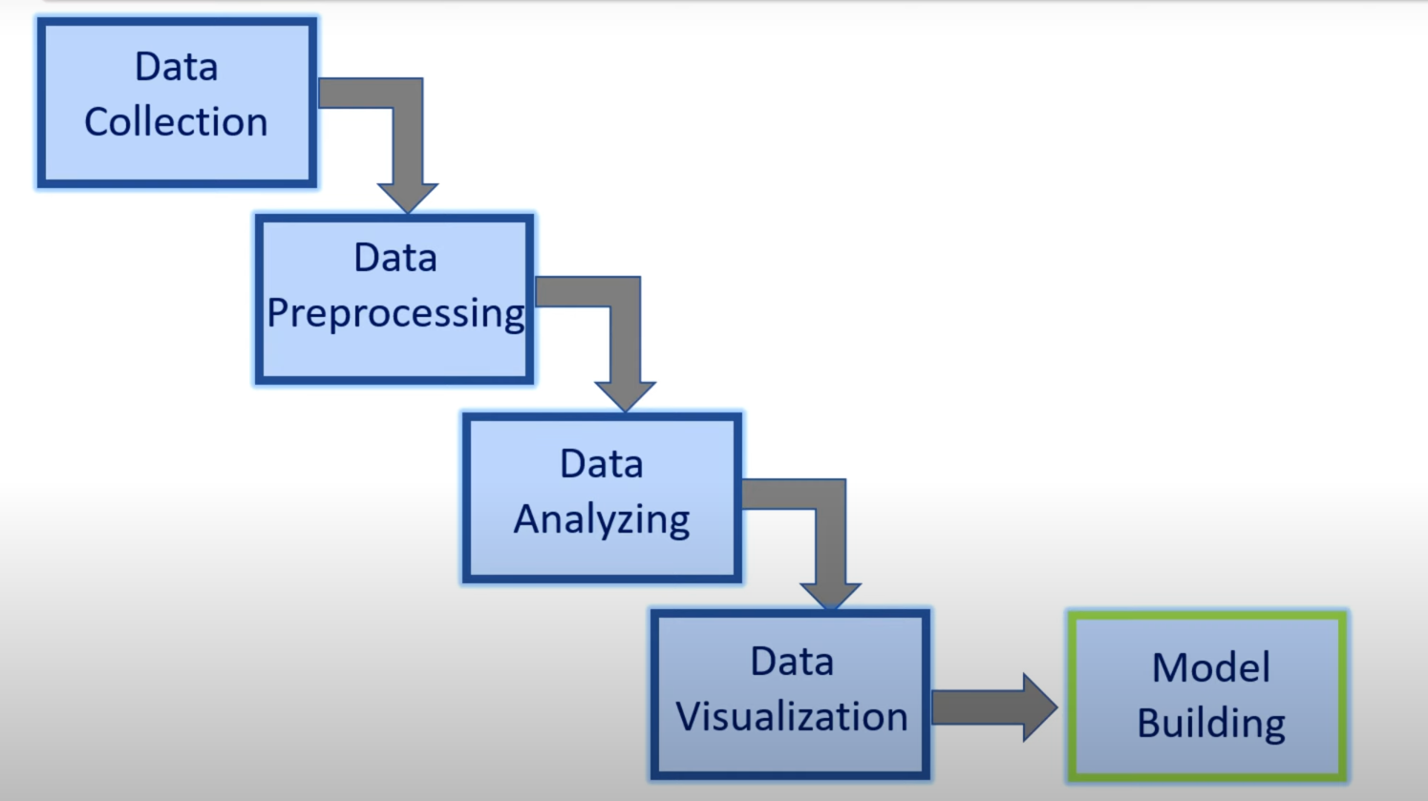
Flowchart

Slide 9
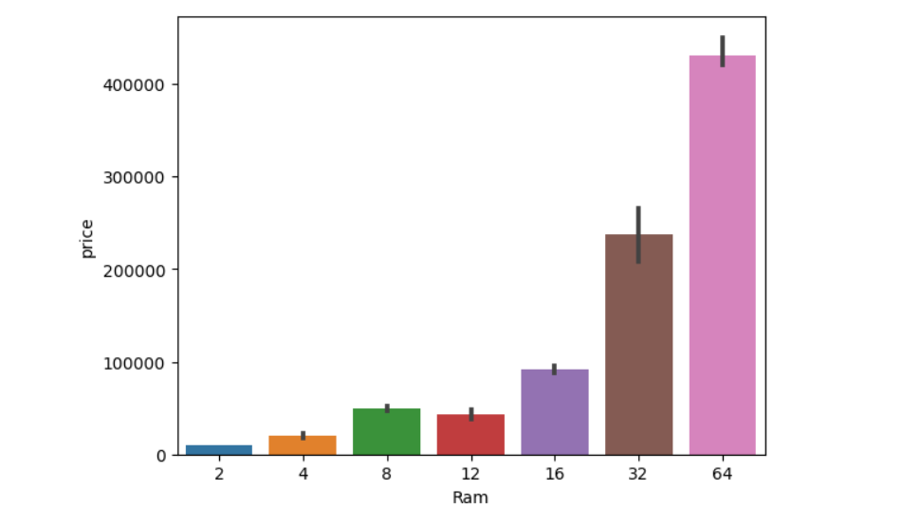
Data Visualization
Relationship between RAM and price

Slide 10
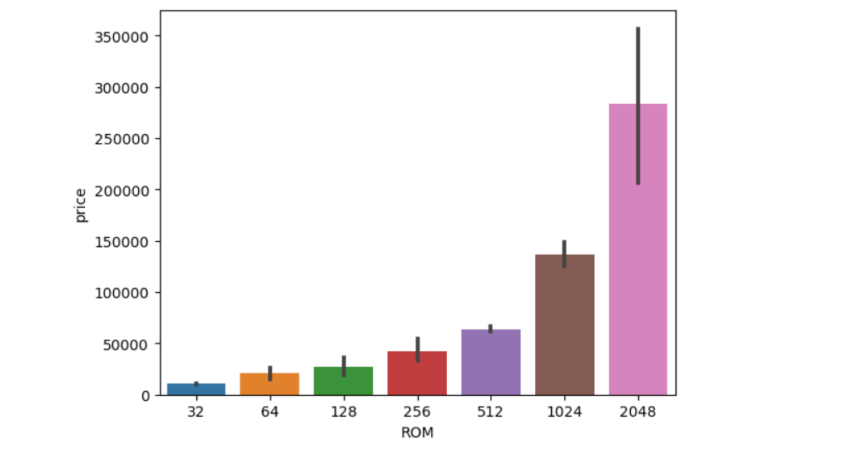
Data Visualization
Relationship between ROM and price

Slide 11
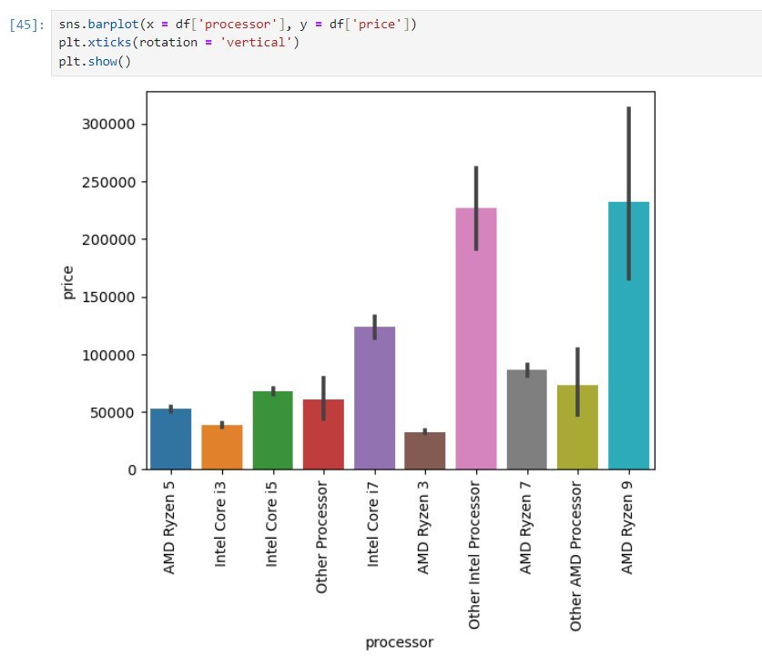
Data Visualization
Relationship between processor and price

Slide 12
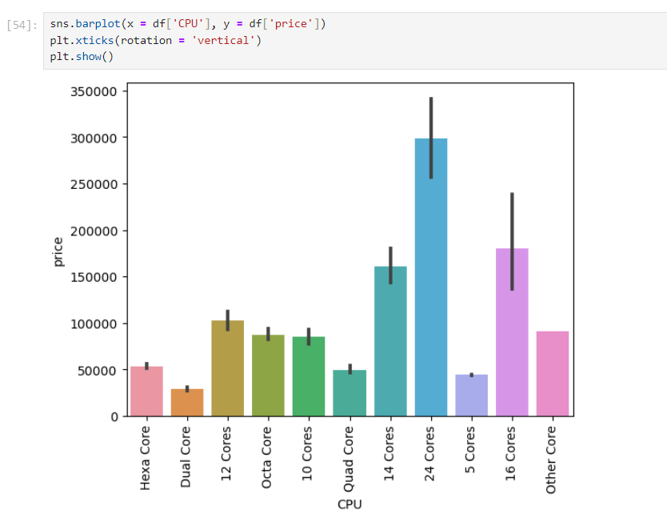
Data Visualization
Relationship between CPU and price

Slide 13
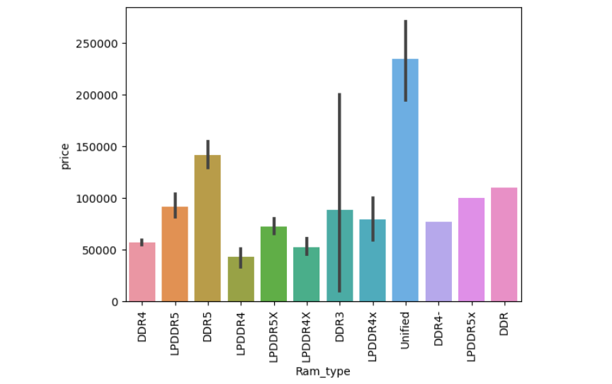
Data Visualization
Relationship between RAM type and price

Slide 14

Conclusion
The project aimed to predict laptop prices based on user configurations.
Despite having a noisy dataset, feature engineering and preprocessing played a crucial role.
Linear Regression Model exhibited high accuracy in predicting laptop prices.
These results benefit both consumers and businesses.

Slide 15
Reference
Dataset link https://www.kaggle.com/datasets/jacksondivakarr/laptop-price-prediction-dataset

Slide 16


